Slide 1
Identifying and Mitigating Accountability Risks
What Is Accountability?
Identify Accountability Risks
Accountability Tradeoffs
Mitigate Accountability Risks

Slide 2
What Is Accountability?
Topic A

Slide 3
Accountability
Accountability: The practice of holding agents responsible for outcomes, processes, actions, or intentions.
Operates as a social relationship, where someone is accountable to someone else for something according to some set of standards.
Comes with the possibility of sanction.
Also seeks to deter misconduct and incentivize good conduct.
Operates retrospectively, after an event occurs.
Both a virtue and a mechanism.

Slide 4

Why Should We Care About Accountability?
Allows us to identify and correct mistakes.
Promotes truth and transparency.
Provides an important check on power.
Builds trust with stakeholders.

Slide 5

Accountability in Emerging Technologies
Great potential for harm and benefit.
Highly complex processes that may be opaque or poorly understood.
Problem of “many hands,” where many different parties being involved leads to confusion about who is accountable.
Lack of human control over automated systems (accountability gaps).
Lack of adequate regulation and standards leads to poor oversight.

Slide 6
Activity: Discussing Accountability Basics
Scenario: General discussion.
Can you describe a situation in your professional life where you observed a lack of accountability?
At your workplace, what are some of the barriers to stronger accountability practices?

Slide 7
Identify Accountability Risks
Topic B

Slide 8



Sources for Accountability Risks
Technical issues.
Organizational issues.
Regulatory issues.

Slide 9
Technical Accountability Risks
Technical Accountability Risk Type | Description
Opacity/black box processes | Using techniques like machine learning that are inherently opaque creates more opportunities for accountability failures.
Use of third-party components (open-source libraries, etc.) | The origins and qualities of third-party data sets, products, and tools may be unknown, insecure, erroneous, or biased, making it difficult to trace processes and decisions.
Lack of documentation of decisions and processes | When people are working quickly, it is easy to forget to document decisions made and the rationales behind them; but this creates more problems down the line.
Task delegation to autonomous systems/lack of human control | It is often unclear where responsibility lies when autonomous systems result in controversial or harmful actions.
Processes in decentralized systems such as blockchain technologies | Decentralized processes can involve automated execution of code, for which no human user is accountable, and might obfuscate activities of malicious actors.

Slide 10
Organizational and Regulatory Accountability Risks
Organizational/Regulatory Accountability Risk Type | Description
Lack of legal regulation and common standards | Regulations that are vague, contradictory, or missing make it difficult for technology producers to know how to account for their actions, and to whom.
Lack of internal guiding principles | Teams and organizations that do not establish shared guiding principles lack clear expectations of goals, limits, and virtues.
Lack of clear lines of responsibility and liability for decisions | Confusion about roles, or who is liable for what kinds of decisions, makes it difficult to attribute responsibility and sanctions when things go wrong (or right).
Lack of external oversight | Organizations and teams that do not invite scrutiny from external auditors are less likely to establish strong accountability protocols.
Lack of an accountable culture | An organization’s culture can lack accountability by promoting behaviors that oppose it. A typical case would be the Silicon Valley mentality of “move fast and break things.”
Case of crises | Risks emerging in time of emergency.

Slide 11

Accountability Standards and Regulations
Sarbanes-Oxley Act of 2002
The European Commission’s Independent High-Level Expert Group on Artificial Intelligence guidelines for trustworthy AI
Fairness, Accountability, and Transparency in Machine Learning (FAT/ML) principles
Institute for Electrical and Electronics Engineers (IEEE)’s Global Initiative on Ethics of Autonomous and Intelligent Systems
U.S. Algorithmic Accountability Act of 2019—not adopted, but it proposed impact assessment for automated decision-making systems

Slide 12
Activity: Identifying Potential Sources of Accountability Risks
Scenario: Consider the RudiBrace product, or a product from your workplace.
Which types of technical accountability risks do you think are most important?
Which types of organizational or regulatory accountability risks do you think are most important?
Which types of technical accountability risks do you think need to be mitigated with the greatest urgency?
Which types of organizational or regulatory accountability risks do you think need to be mitigated with the greatest urgency?

Slide 13
Accountability Tradeoffs
Topic C

Slide 14
Common Accountability Tradeoffs
Efficiency
Accountability
Profit
Power
Growth

Slide 15

Efficiency Tradeoffs (Slide 1 of 2)
Speed
Consistency
Objectivity
Transparency
Responsibility
Traditional accountability mechanisms

Slide 16
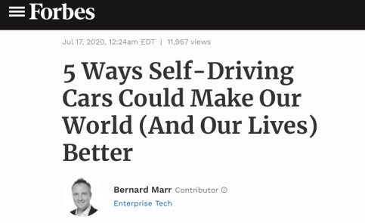

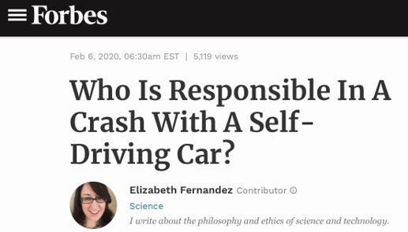
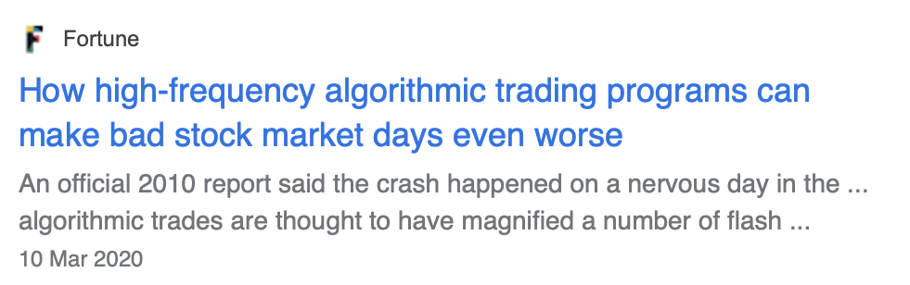
Efficiency Tradeoffs (Slide 2 of 2)

Slide 17
Power, Growth, and Profit Tradeoffs (Slide 1 of 2)
Growth and profit
User engagement
Competitive advantage
Transparency
Regulation
Content moderation

Slide 18
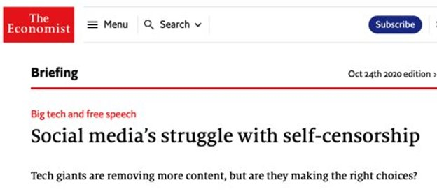
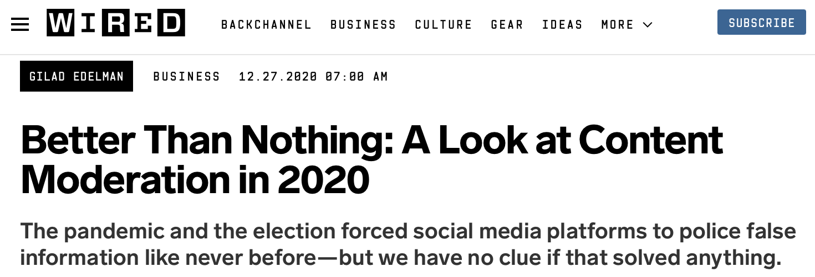
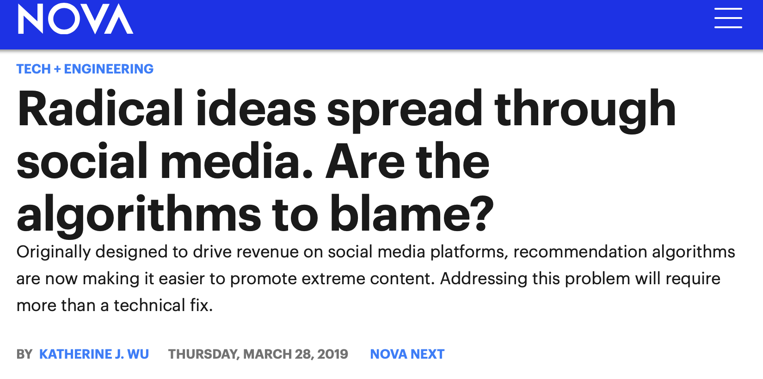
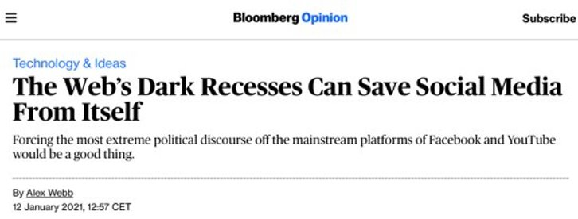
Power, Growth, and Profit Tradeoffs (Slide 2 of 2)

Slide 19
Activity: Discussing Accountability Tradeoffs
Scenario: General discussion.
If autonomous weapons systems could be shown to significantly reduce civilian deaths in war, does this mean a potential lack of accountability shouldn’t stop us from using the technology?
If self-driving cars could be shown to significantly reduce the number of accidents in domestic traffic, does this mean a potential lack of accountability shouldn’t stop us from using the technology?

Slide 20
Mitigate Accountability Risks
Topic D

Slide 21
Accountability Risk Mitigation Strategies (Slide 1 of 2)
At the organizational level:
Document company policies clearly.
Provide them to all design and development teams.
Establish review boards from within or outside your organization.
They will provide oversight of sensitive decisions.
Provide opportunities for stakeholders to report concerns, contest outcomes, and interrogate decisions/processes.
Require credentialing of technical staff and operators of products whenever appropriate.
Cooperate with standard-setting bodies, watchdog organizations, and regulators to improve standards and regulations for your industry
Consider adopting a fair competition policy.
No false claims or disparaging the competitors.
Consider adopting an open data policy.
Make data available to all without restriction.

Slide 22
Accountability Risk Mitigation Strategies (Slide 2 of 2)
At the product design level:
Follow the business conduct guidelines/governance provided by your organization.
Establish lines of responsibility and liability for outcomes of each process.
Establish standard operating procedures for workflow and interactions with customers.
Maintain communication with third-party partners, and clarify division of responsibilities in written contracts.
Consider using visual contracts or smart contracts.
Document and record design processes and decisions with the expectation that you may be audited or investigated.
Pilot-test all products and document results.
Use RACI matrices to establish project roles.

Slide 23
RACI Matrices
RACI matrix: (Responsible, accountable, consulted, informed) A way of allocating project roles in a manner that promotes accountability.
Project team members
Task
Project tasks
R = Person responsible (Who will accomplish the task?)
A = Accountable (Who oversees the project and communicates outcomes?)
C = Consulted (Who will provide input?)
I = Informed (Who is told about progress and completion but does not supervise or provide input?)

Slide 24





Mitigation Tools
Algorithmic Impact Assessment
Responsible AI Design Assistant
Data visualization and dashboard reporting
Auditing framework
Human in/on the loop

Slide 25
Activity: Mitigating Accountability Risks
Scenario: Consider the RudiBrace product, or a product from your workplace.
Complete this RACI matrix for the RudiBrace team as it plans to test its product on volunteers.
Compare your matrix with other participants, and discuss the differences that you notice.
Are there other project team members who should be consulted or informed about any of these risks?
 | Chief Product Officer | Project Manager | Hardware Engineer | Data Scientist | User Experience Designer | Software Engineer
Create test plan and KPIs/KRIs
Interview test subjects
Record and analyze test data
Monitor software performance
Confirm device safety

Slide 26
Completed RudiBrace RACI Matrix
 | Chief Product Officer | Project Manager | Hardware Engineer | Data Scientist | User Experience Designer | Software Engineer
Create test plan and KPIs/KRIs | A | R | C | C | C | C
Interview test subjects | -- | A | I | C | R | I
Record and analyze test data | -- | A | C | R | C | C
Monitor software performance | -- | A | I | C | I | R
Confirm device safety | -- | A | R | I | C | I

Slide 27
Which types of accountability risk do you think your organization faces most often, and why?
Which of the accountability risk mitigation strategies do you think your organization is most likely to adopt, and why?

